Slide 1
recommendation engine

Slide 2
1.
Q1
Recommendation engine
What? Why? How?

Slide 3
What is recommendation engine?
1st visit?
S
D
X
L
Filters the data using different algorithms
Captures the past behavior of a customer
Recommends the most relevant items to users that likely to buy
Recommend best selling products
Recommend products which could bring maximum profit

Slide 4
Why recommendation engine?
S
D
X
L
create a positive impact on the user experience
Lead to frequent visits
Improve the quality and effectiveness of marketing campaign
Increase the sales and profit rate

Slide 5
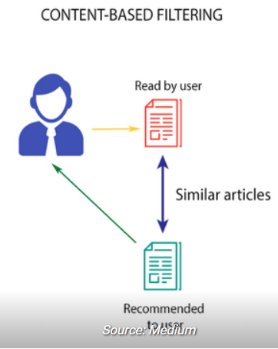
How does recommendation engine works?
S
D
X
L
Content based filtering
Recommends products which are similar to the ones that a user has liked in the past
Examples: Netflix

Slide 6
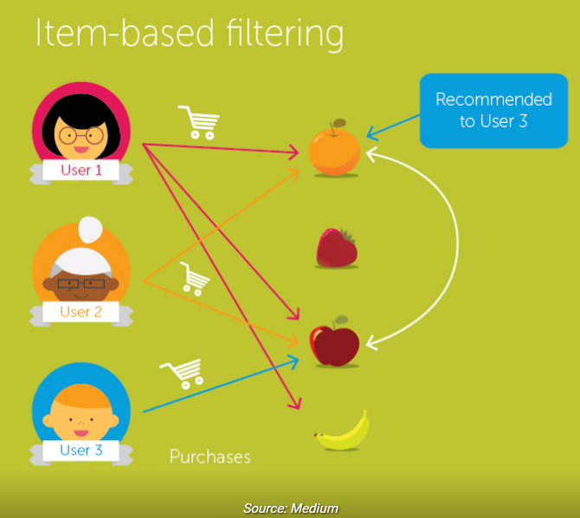
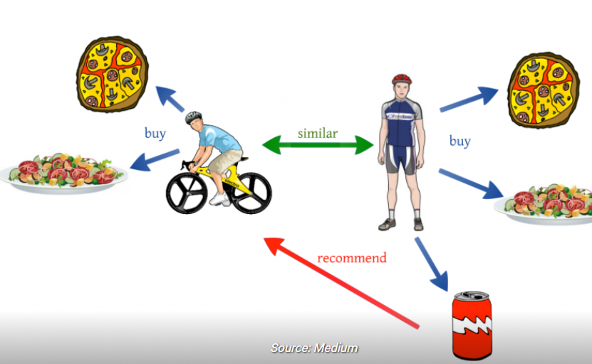
How does recommendation engine works?
S
D
X
L
Collaborative filtering
User - User
Item - Item
Example: Amazon, Social network

Slide 7
Recommendation Engine Approaches
S
D
X
L
Multi-criteria recommender systems
Risk-aware recommender systems
Mobile recommender systems
Hybrid recommender systems

Slide 8
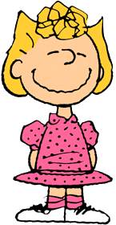



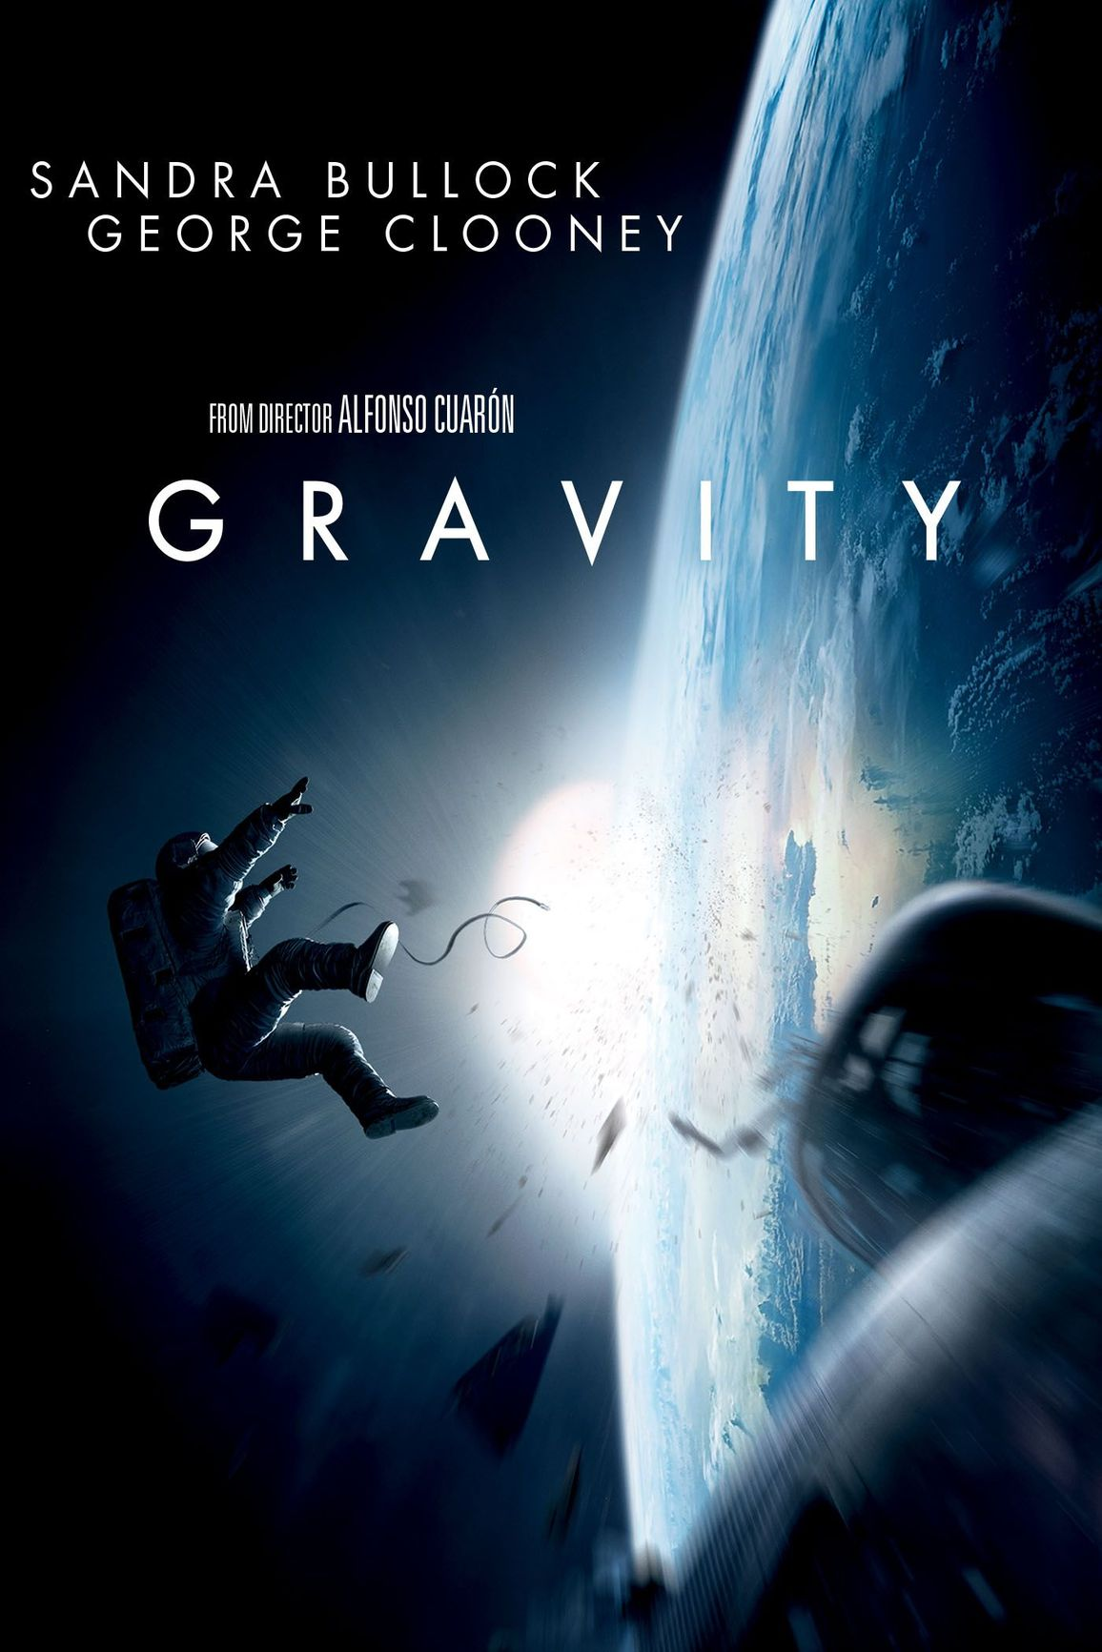
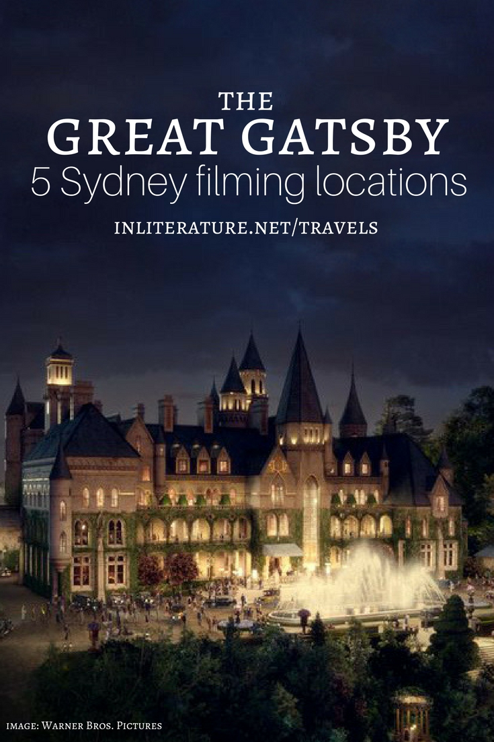
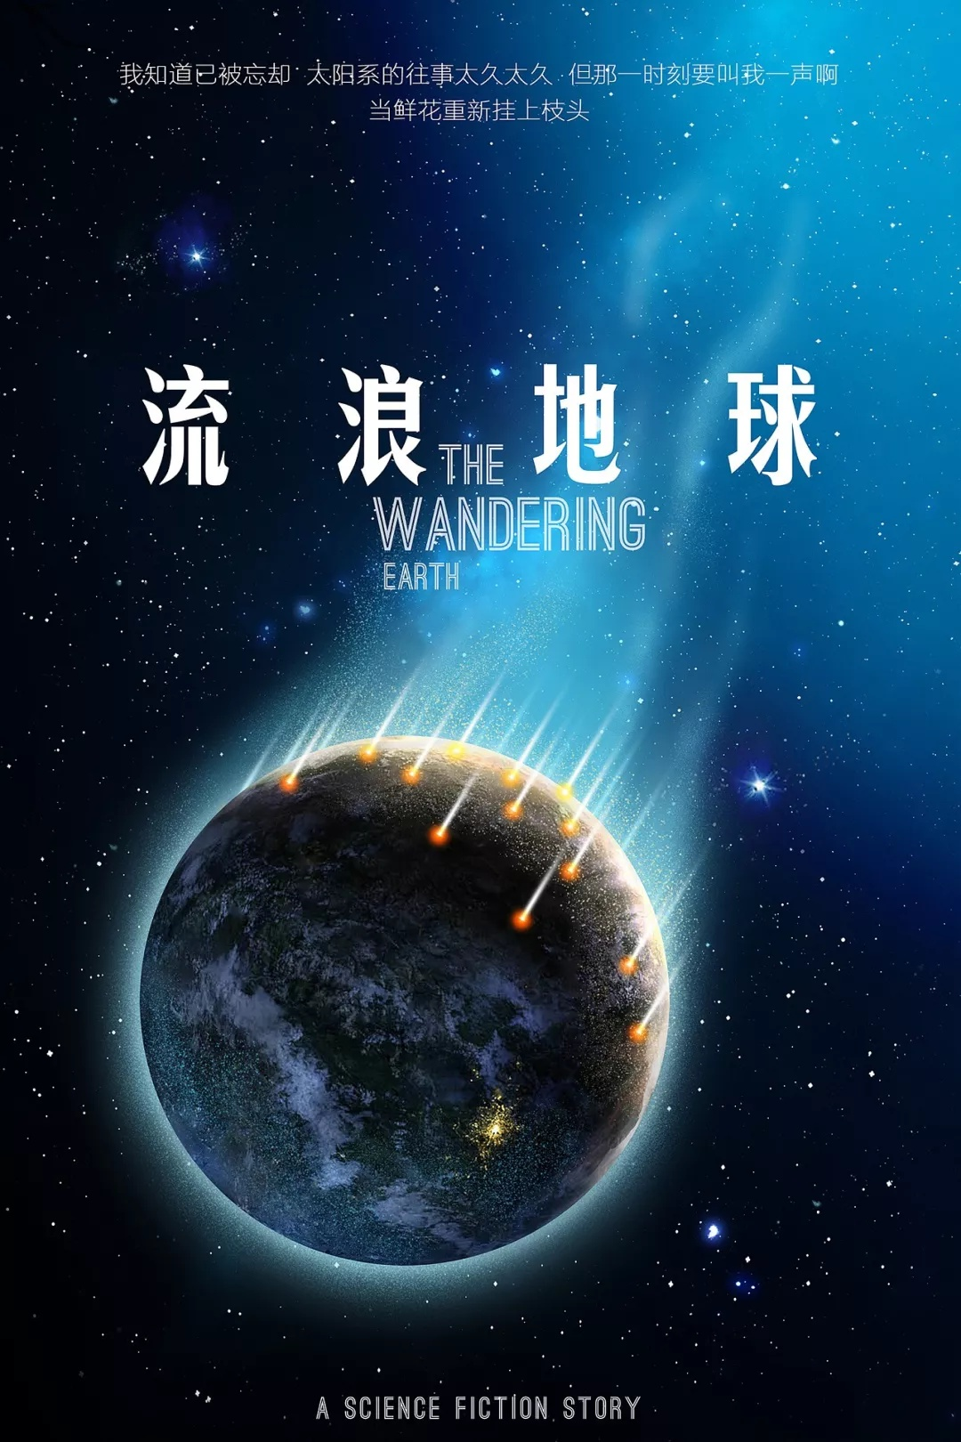

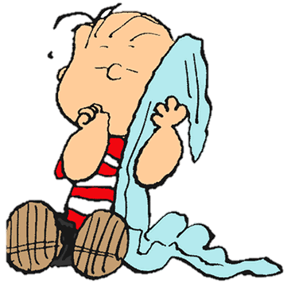
Sally
M1
M2
Lucy
Pepper
Linus
M3
M4
M5

Slide 9
Ratings
 | M1 | M2 | M3 | M4 | M5
 | 3 | 1 | 1 | 3 | 1
 | 1 | 2 | 4 | 1 | 3
 | 3 | 1 | 1 | 3 | 1
 | 4 | 3 | 5 | 4 | 4
5/5
M1
3/5

Slide 10
Ratings
 | M1 | M2 | M3 | M4 | M5
 | 3 | 1 | 1 | 3 | 1
 | 1 | 2 | 4 | 1 | 3
 | 3 | 1 | 1 | 3 | 1
 | 4 | 3 | 5 | 4 | 4

Slide 11
Ratings
 | M1 | M2 | M3 | M4 | M5
 | 3 | 1 | 1 | 3 | 1
 | 3 | 1 | 1 | 3 | 1
=

Slide 12
Ratings
 | M1 | M2 | M3 | M4 | M5
 | 3 | 1 | 1 | 3 | 1
 | 1 | 2 | 4 | 1 | 3
 | 3 | 1 | 1 | 3 | 1
 | 4 | 3 | 5 | 4 | 4

Slide 13
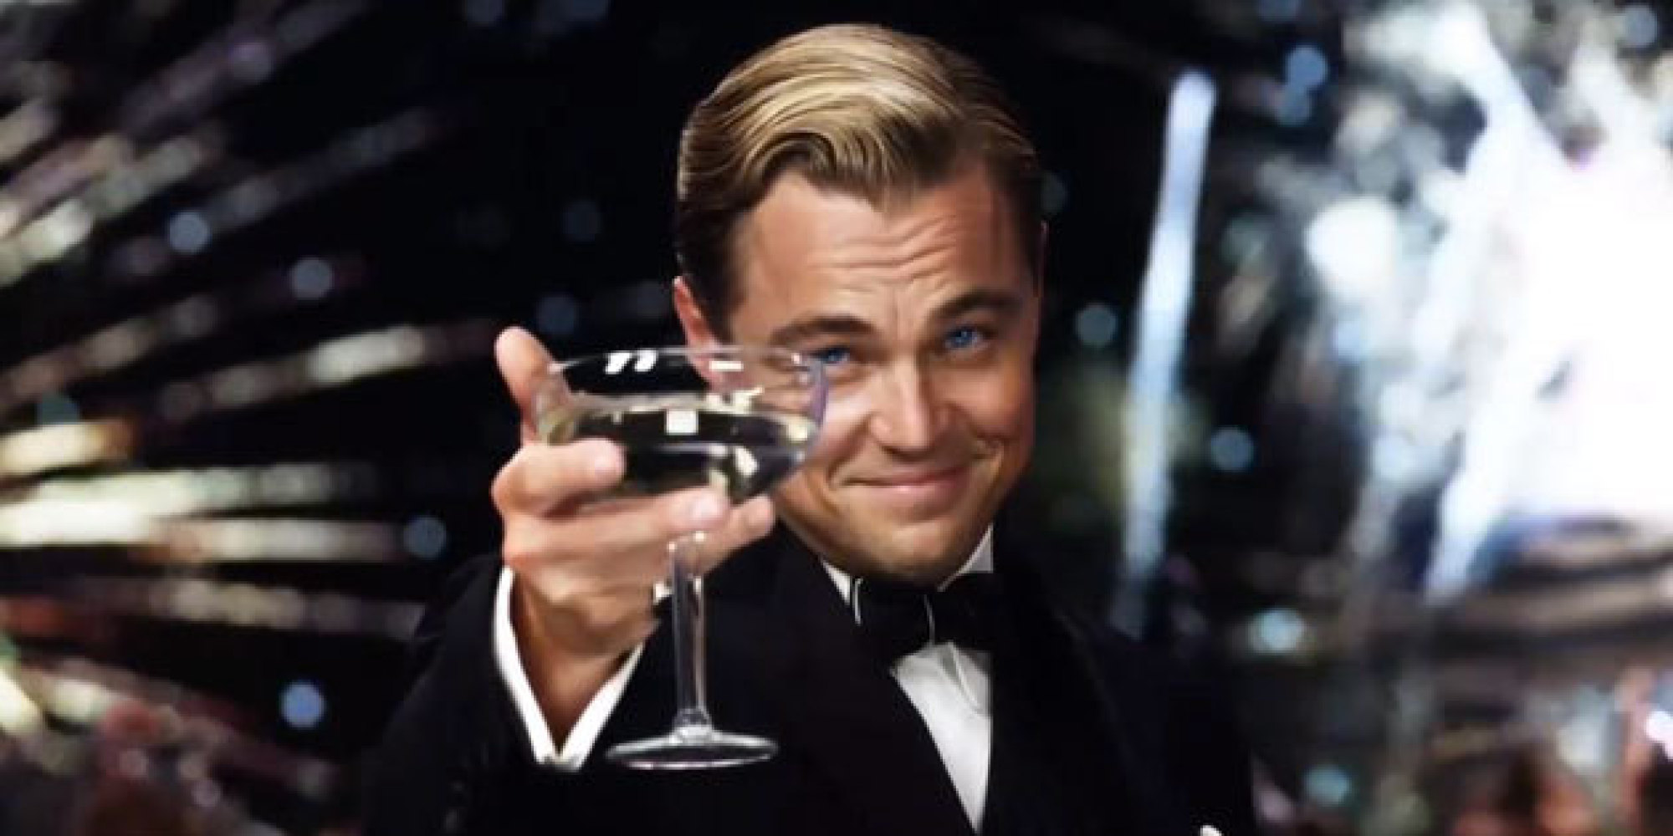
Hidden Dependency
 | M1 | M2 | M3 | M4 | M5
 | 3 |  |  | 3
 | 1 |  |  | 1
 | 3 |  |  | 3
 | 4 |  |  | 4
M1 = M4

Slide 14
Ratings
 | M1 | M2 | M3 | M4 | M5
 | 3 | 1 | 1 | 3 | 1
 | 1 | 2 | 4 | 1 | 3
 | 3 | 1 | 1 | 3 | 1
 | 4 | 3 | 5 | 4 | 4

Slide 15
Hidden Dependency
 | M1 | M2 | M3 | M4 | M5
 | 1 | 2 | 4 | 1 | 3
 | 3 | 1 | 1 | 3 | 1
 | 4 | 3 | 5 | 4 | 4
+
=

Slide 16
Hidden Dependency
+
=
M2
M4
M3
M1
M5
Drama
Science Fiction

Slide 17
Hidden Dependency
 | M1 | M2 | M3 | M4 | M5
 | 1 | 2 | 4 | 1 | 3
 | 3 | 1 | 1 | 3 | 1
 | 4 | 3 | 5 | 4 | 4
+
=
Drama
&
Si-Fi
Si-Fi
Drama

Slide 18
Ratings
 | M1 | M2 | M3 | M4 | M5
 | 3 | 1 | 1 | 3 | 1
 | 1 | 2 | 4 | 1 | 3
 | 3 | 1 | 1 | 3 | 1
 | 4 | 3 | 5 | 4 | 4

Slide 19
Hidden Dependency on rows and columns
 | M1 | M2 | M3 | M4 | M5
 |  | 1 | 1 |  | 1
 |  | 2 | 4 |  | 3
 |  | 1 | 1 |  | 1
 |  | 3 | 5 |  | 4
M5
M3
= Average( , )
M2

Slide 20
Prediction
M5 = ?
 | M1 | M2 | M3 | M4 | M5
 | 3 | 1 | 1 | 3 | 1
 | 1 | 2 | 4 | 1 | 3
 | 3 | 1 | 1 | 3
 | 4 | 3 | 5 | 4 | 4
Pepper hasn’t watch Movie 5.
What’s his rating on M5?
Dependency
=
1
M5
1/5

Slide 21
2.
Q5
What is matrix factorization?

Slide 22
What is Matrix Factorization?
S
D
X
L
A class of collaborative filtering algorithms
A kind of Latent factor model
Decomposing the user-item interaction matrix into the product of two lower dimensionality rectangular matrices

Slide 23
Why?
Superior to classic nearest-neighbor techniques:
allowing the incorporation of additional information such as implicit feedback, temporal effects, and confidence levels
Solving the problems:
The amount of information does not increase linearly with the increase of the vector dimension because of the correlation between the items
The matrix elements are sparse.(so the calculation result is unstable, resulting a large difference when change the vector dimensions.)

Slide 24
Matrix Factorization
Matrix Factorization is a simple embedding model. Given the feedback matrix A ∈Rm×n, where m is the number of users (or queries) and n is the number of items, the model learns:
A user embedding matrix U∈Rm×d, where row i is the embedding for user i.
An item embedding matrix V∈Rn×d, where row j is the embedding for item j.

Slide 25
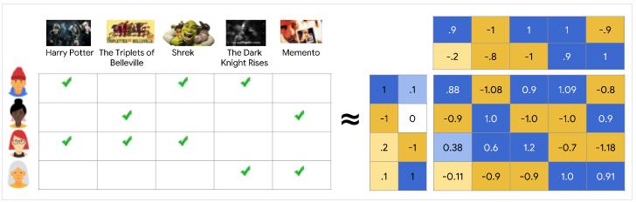
Matrix Factorization
The embeddings are learned such that the product UVT is a good approximation of the feedback matrix A. Observe that the (i,j) entry of U.VT is simply the dot product ⟨Ui,Vj⟩ of the embeddings of user i and item j, which you want to be close to Ai,j.

Slide 26
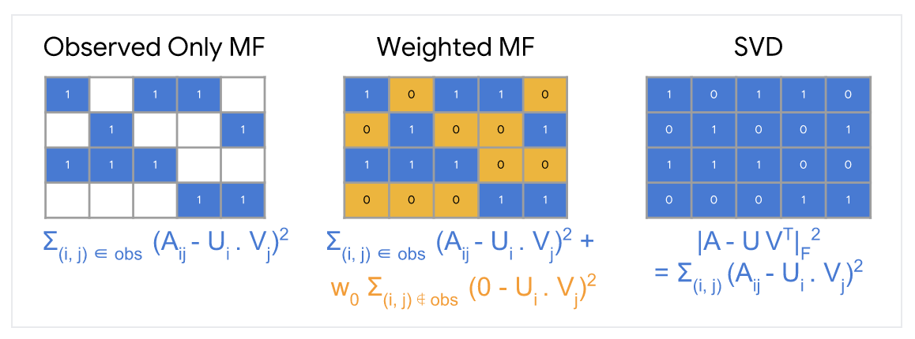
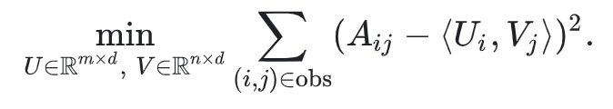
Matrix Factorization

Slide 27
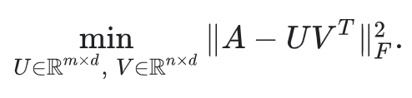
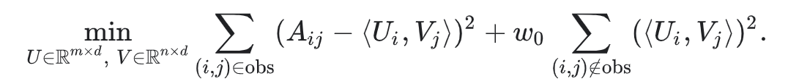
Matrix Factorization
SVD
NMF
Loss function can be minimized by SGD, ALS

Slide 28
Other Matrix Factorization Models
S
D
X
L
SVD++
Asymmetric SVD
Hybrid Matrix Factorization
Deep-Learning Matrix Factorization

Slide 29
S
D
X
L
Quotations are commonly printed as a means of inspiration and to invoke philosophical thoughts from the reader.

Slide 30
Big concept
S
D
X
L
Bring the attention of your audience over a key concept using icons or illustrations

Slide 31
You can also split your content
S
D
X
L
White
Is the color of milk and fresh snow, the color produced by the combination of all the colors of the visible spectrum.
Black
Is the color of coal, ebony, and of outer space. It is the darkest color, the result of the absence of or complete absorption of light.

Slide 32
In two or three columns
S
D
X
L
Yellow
Is the color of gold, butter and ripe lemons. In the spectrum of visible light, yellow is found between green and orange.
Blue
Is the colour of the clear sky and the deep sea. It is located between violet and green on the optical spectrum.
Red
Is the color of blood, and because of this it has historically been associated with sacrifice, danger and courage.

Slide 33

A picture is worth a thousand words
S
D
X
L
A complex idea can be conveyed with just a single still image, namely making it possible to absorb large amounts of data quickly.

Slide 34

Want big impact?
Use big image.
S
D
X
L

Slide 35
hello!
I am Jayden Smith
I am here because I love to give presentations.
You can find me at @username

Slide 36
Use charts to explain your ideas
S
D
X
L
White
Gray
Black

Slide 37
And tables to compare data
S
D
X
L
 | A | B | C
Yellow | 10 | 20 | 7
Blue | 30 | 15 | 10
Orange | 5 | 24 | 16

Slide 38
Maps
S
D
X
L
our office

Slide 39
89,526,124
S
D
X
L
Whoa! That’s a big number, aren’t you proud?

Slide 40
89,526,124$
185,244 users
100%
S
D
X
L
That’s a lot of money
And a lot of users
Total success!

Slide 41
Our process is easy
S
D
X
L
first
second
last

Slide 42
Let’s review some concepts
S
D
X
L
Yellow
Is the color of gold, butter and ripe lemons. In the spectrum of visible light, yellow is found between green and orange.
Blue
Is the colour of the clear sky and the deep sea. It is located between violet and green on the optical spectrum.
Red
Is the color of blood, and because of this it has historically been associated with sacrifice, danger and courage.
Yellow
Is the color of gold, butter and ripe lemons. In the spectrum of visible light, yellow is found between green and orange.
Blue
Is the colour of the clear sky and the deep sea. It is located between violet and green on the optical spectrum.
Red
Is the color of blood, and because of this it has historically been associated with sacrifice, danger and courage.

Slide 43
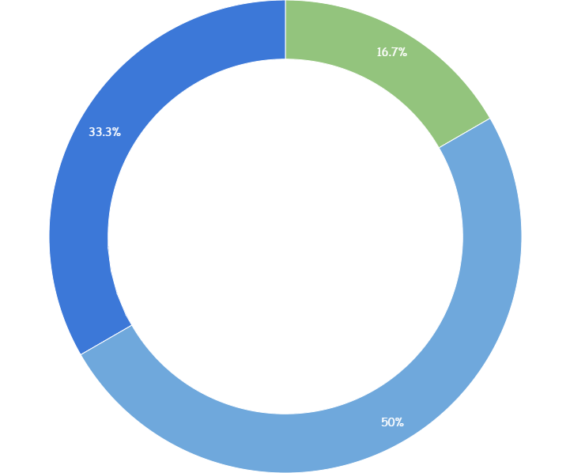
S
D
X
L
You can copy&paste graphs from Google Sheets

Slide 44
S
D
X
L
Place your screenshot here
Android project
Show and explain your web, app or software projects using these gadget templates.

Slide 45
S
D
X
L
Place your screenshot here
iPhone project
Show and explain your web, app or software projects using these gadget templates.

Slide 46
S
D
X
L
Place your screenshot here
Tablet project
Show and explain your web, app or software projects using these gadget templates.

Slide 47
S
D
X
L
Place your screenshot here
Desktop project
Show and explain your web, app or software projects using these gadget templates.

Slide 48
thanks!
S
D
X
L
Any questions?
You can find me at
@username
user@mailme

Slide 49
Credits
S
D
X
L
Special thanks to all the people who made and released these awesome resources for free:
Presentation template by SlidesCarnival
Photographs by Unsplash

Slide 50
Presentation design
S
D
X
L
This presentation uses the following typographies:
Titles: Walter Turncoat
Body copy: Sniglet
You can download the fonts on these pages:
https://www.fontsquirrel.com/fonts/walter-turncoat
https://www.fontsquirrel.com/fonts/sniglet
You don’t need to keep this slide in your presentation. It’s only here to serve you as a design guide if you need to create new slides or download the fonts to edit the presentation in PowerPoint®

Slide 51
Extra graphics
S
D
X
L

Slide 52

Free templates for all your presentation needs
For PowerPoint and Google Slides
100% free for personal or commercial use
Ready to use, professional and customizable
Blow your audience away with attractive visuals

Slide 53

SlidesCarnival icons are editable shapes.
This means that you can:
Resize them without losing quality.
Change fill color and opacity.
Isn’t that nice? :)
Examples:

Slide 54
😉
Now you can use any emoji as an icon!
And of course it resizes without losing quality and you can change the color.
How? Follow Google instructions https://twitter.com/googledocs/status/730087240156643328
✋👆👉👍👤👦👧👨👩👪💃🏃💑❤😂😉😋😒😭👶😸🐟🍒🍔💣📌📖🔨🎃🎈🎨🏈🏰🌏🔌🔑 and many more...

